Slide 1
The Smarter Balanced Assessment Consortium
Navigating Resources in the Digital Library
Notes:
Welcome to the Navigating Resources in the Digital Library Help Topic. The information will help you explore the available features for a resource once you have found it.

Slide 2
Topics
How do I view resource materials? (slides 3 – 7)
What information will I find in the About This Resource tab? (slides 8 – 16)
How do I write a review for a resource and rate it?
(slides 17 – 24)
How do I share a resource? (slides 25 – 28)
How do I locate similar resources in the Digital Library? (slides 29 – 32)
How do I flag an issue with a resource in the Digital Library? (slides 33 – 38)
Notes:
There are a number of topics for Navigating Resources in the Digital Library. They are:
How do I view resource materials?
What information will I find in the About This Resource tab?
How do I write a review for a resource and rate it?
How do I share a resource?
How do I locate similar resources in the Digital Library?
How do I flag an issue with a resource in the Digital Library?
Let’s start with downloading materials in a resource.

Slide 3
Topics
How do I view resource materials?
What information will I find in the About This Resource tab?
How do I write a review for a resource and rate it?
How do I share a resource?
How do I locate similar resources in the Digital Library?
How do I flag an issue with a resource in the Digital Library?
Notes:
Let’s start with viewing resource materials.

Slide 4
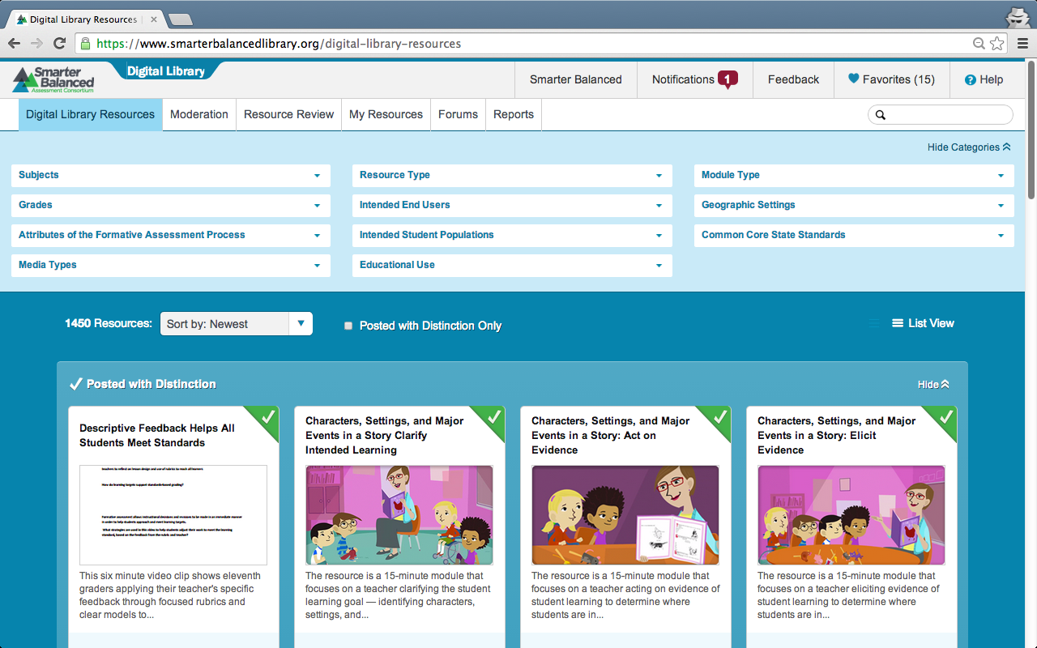
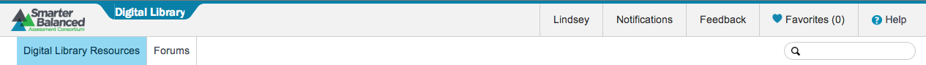
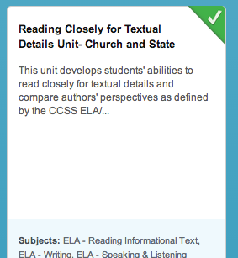
View Resource Materials
Notes:
Recall that you can search for and view resources when you are in the Digital Library Resources tab.
To access a resource, click on the title.

Slide 5
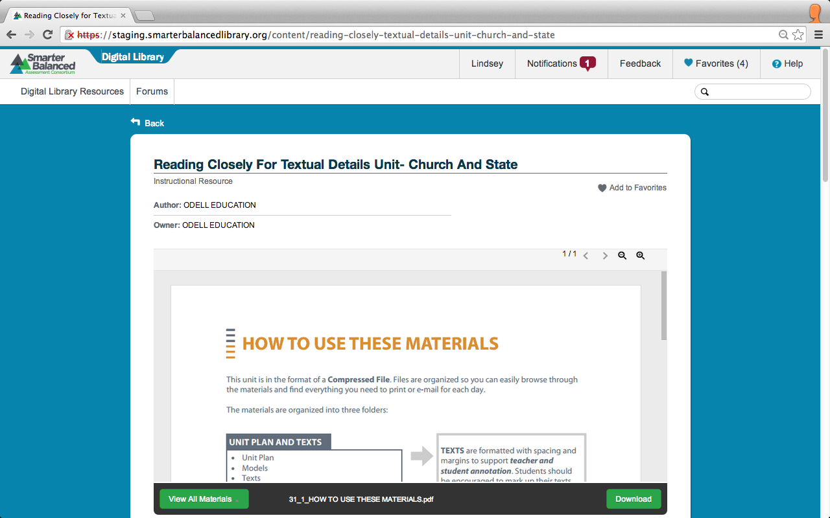
View Resource Materials
Notes:
After you click on the title, you are taken to the resource page. At the top of the resource page you will find the resource title, resource type, author, and owner. Resources may be made up of one or more sets of materials. The preview window displays the primary material. In this example, the primary material is titled “How to Use These Materials.”

Slide 6
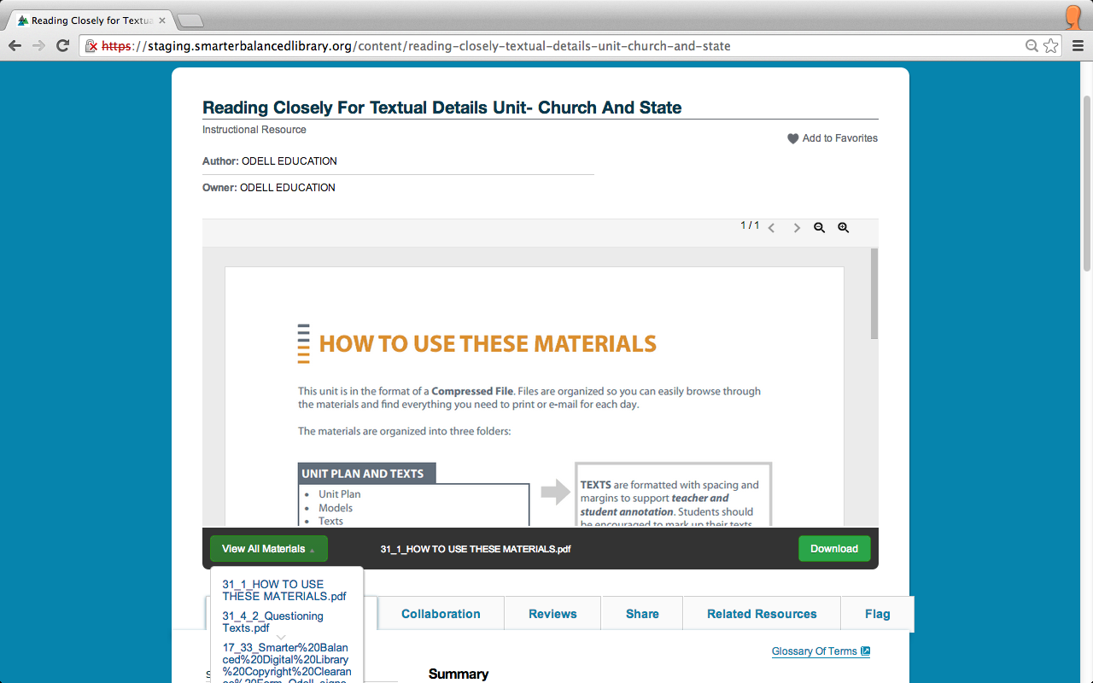
View Resource Materials
Notes:
There are two ways to view the resource materials:
The first way is to use the Preview window. As mentioned in the previous slide, the primary material will be displayed by default.
To view the secondary or additional resource materials (if there are any), click the View All Materials button on the bottom left of the preview window. A drop-down menu will appear that lists all the materials associated with this resource. Click on a link in the drop-down menu to view the additional materials in the preview window.

Slide 7
View Resource Materials
Notes:
The second way to view the resource materials is to download them. Click Download in the bottom right corner of the preview window to download all of the materials in a zip file.
Note: You will not be able to download embedded videos. These may only be viewed in the preview window or on the host site (e.g., YouTube).

Slide 8
Topics
How do I view resource materials?
What information will I find in the About This Resource tab?
How do I write a review for a resource and rate it?
How do I share a resource?
How do I locate similar resources in the Digital Library?
How do I flag an issue with a resource in the Digital Library?
Notes:
Let’s explore the information you will find in the About This Resource tab.

Slide 9
About This Resource Tab
Notes:
Recall that you can search for and view resources when you are in the Digital Library Resources tab.
To access a resource, click on the title.

Slide 10
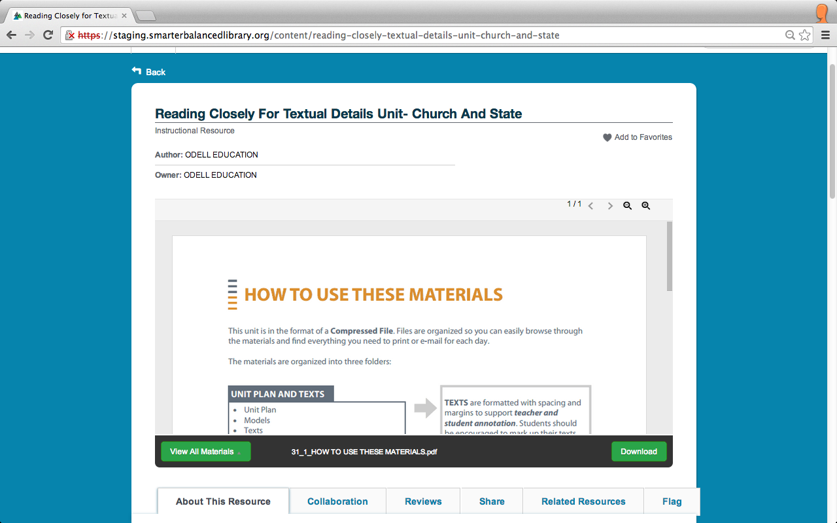
About This Resource Tab
Notes:
After clicking on a resource you are taken to the resource page. Scroll below the preview window and click the About This Resource tab.

Slide 11
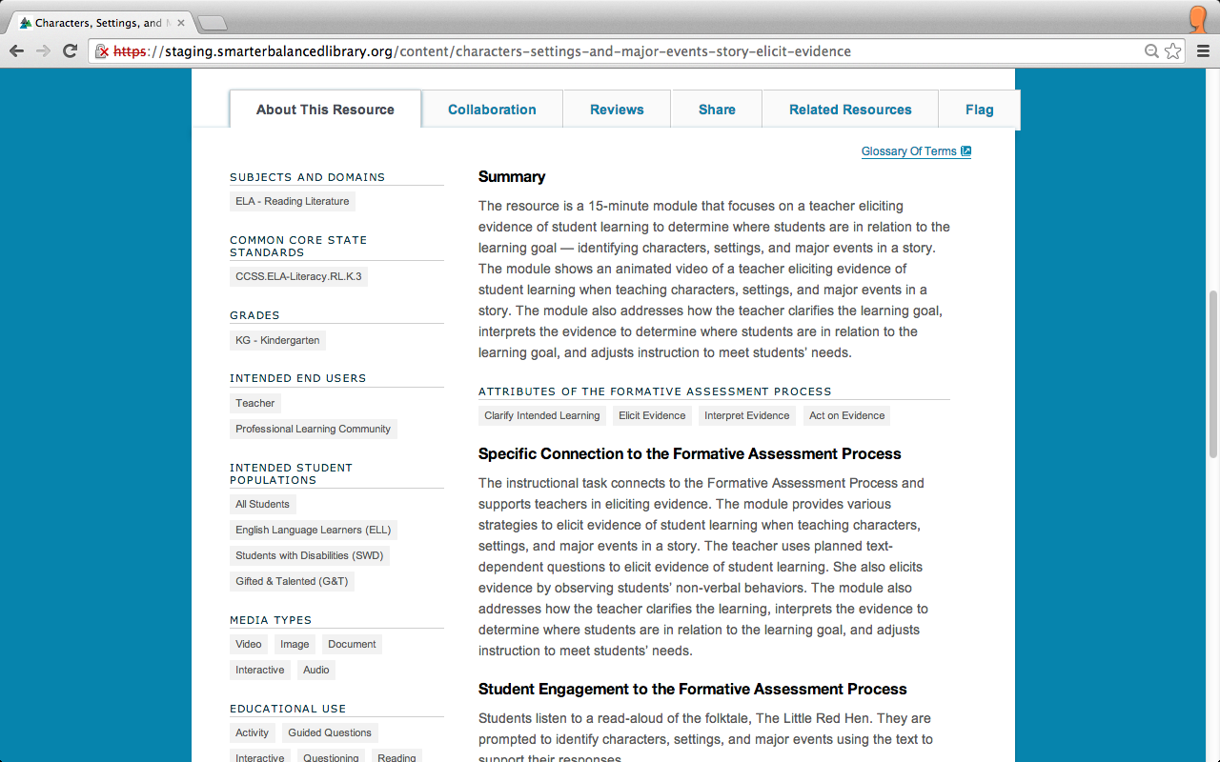
About This Resource Tab
Notes:
The About This Resource tab provides a variety of information:
First, notice the link to the Glossary Of Terms in the top right of the screen. Here you will find explanations for commonly used terms in the Digital Library.
The text you will see is the Summary, which gives a brief description of the resource.

Slide 12
About This Resource Tab
2
Notes:
Down the left side of the About This Resource tab are the tags. These tags include:
Subjects and Domains
Common Core State Standards
Grades
Intended Users
Intended Student Populations
Media Types
Continue scrolling for the rest of the tags associated with a resource.

Slide 13
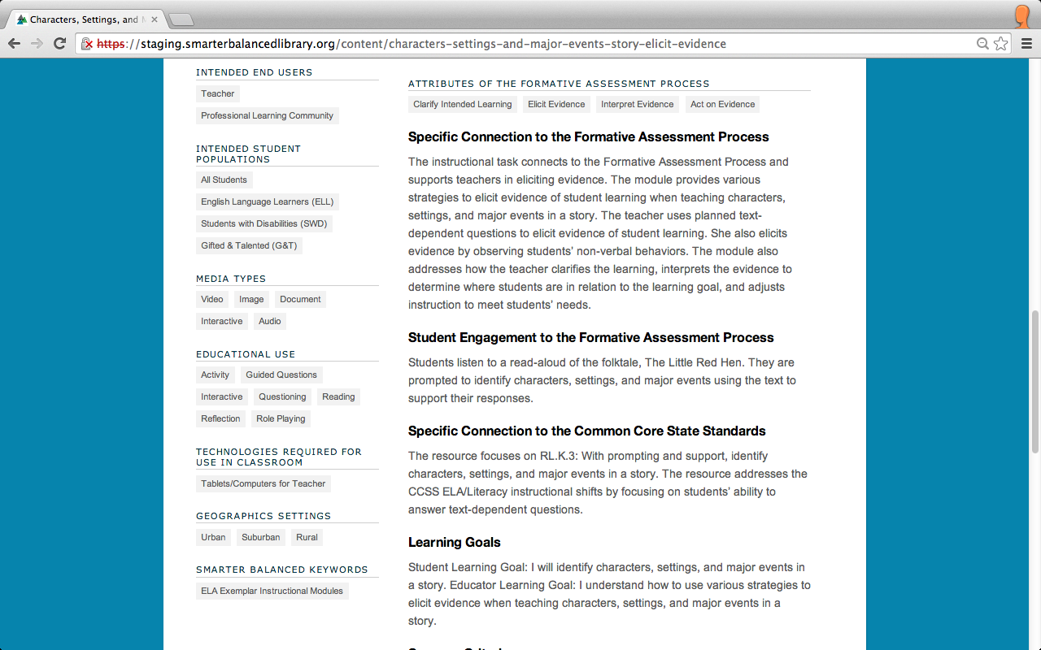
About This Resource Tab
2
Notes:
Other resource tags include:
Educational Use
Technologies Required for use in the Classroom
Geographic Settings
Smarter Balanced Keywords
If a resource is not tagged in a field, then that field will not appear in the “About This Resource” tab.

Slide 14
About This Resource Tab
Notes:
The next three fields address the Formative Assessment Process.
Attributes of the Formative Assessment Process identifies the attributes of the Formative Assessment Process that are associated with the resource: Clarify Intended Learning, Elicit Evidence, Interpret Evidence, and/or Act on Evidence.
Specific Connection to the Formative Assessment Process describes how the resource explains, models, or highlights the Formative Assessment Process.
Student Engagement to the Formative Assessment Process describes how the resource enables students to actively engage in the Formative Assessment Process.

Slide 15
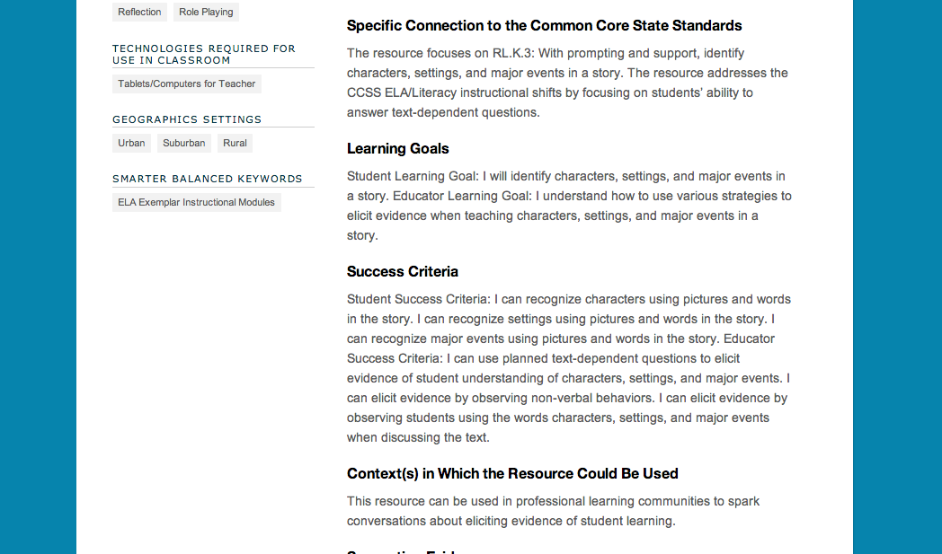
About This Resource Tab
Notes:
Other information that you can find in the About This Resource Tab includes:
Specific Connection to the Common Core State Standards describes how resources help meet the intent of the Common Core State Standards.
The Learning Goals section lists the learning goals for the student for instructional resources, for the educator for professional learning resources, or for both for combination resources.
Success Criteria identify what evidence will be used to determine to what degree learning goals are met.
Context(s) in Which the Resource Could Be Used describes how the materials might be useful, e.g., for classroom instruction or for a Professional Learning Community.

Slide 16
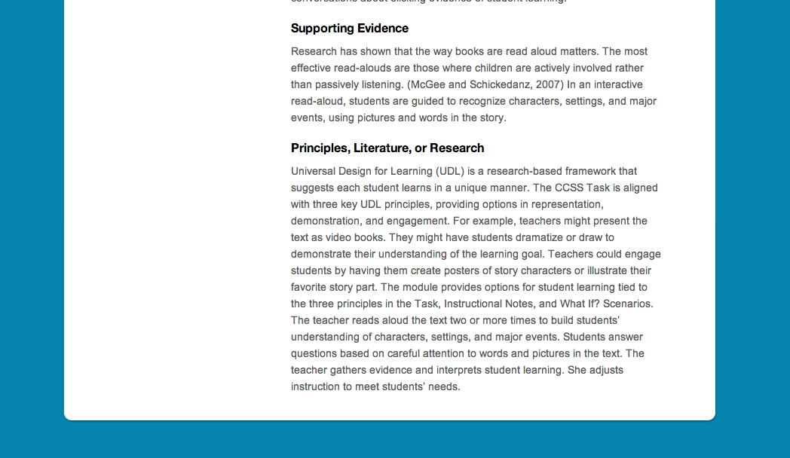
About This Resource Tab
Notes:
The final text fields in the About This Resource Tab are:
Supporting Evidence explains how the resource has been tried successfully with educators or students and/or has resulted in a positive impact on educator practice or student outcomes.
Principles, Literature, or Research describes the principles of adult learning or professional development reflected in the resource, and/or the literature, research, or widely accepted practices used to inform the resource content.

Slide 17
Topics
How do I view resource materials?
What information will I find in the About This Resource tab?
How do I write a review for a resource and rate it?
How do I share a resource?
How do I locate similar resources in the Digital Library?
How do I flag an issue with a resource in the Digital Library?
Notes:
Next let’s examine how to write a review for a resource and rate it.

Slide 18
Reviewing and Rating Resources
Notes:
Again, start in the Digital Library Resource tab to find resources. Click on the title of a resource to access it.

Slide 19
Reviewing and Rating Resources
Notes:
After clicking on a resource, scroll below the preview window and click on the Reviews tab.

Slide 20
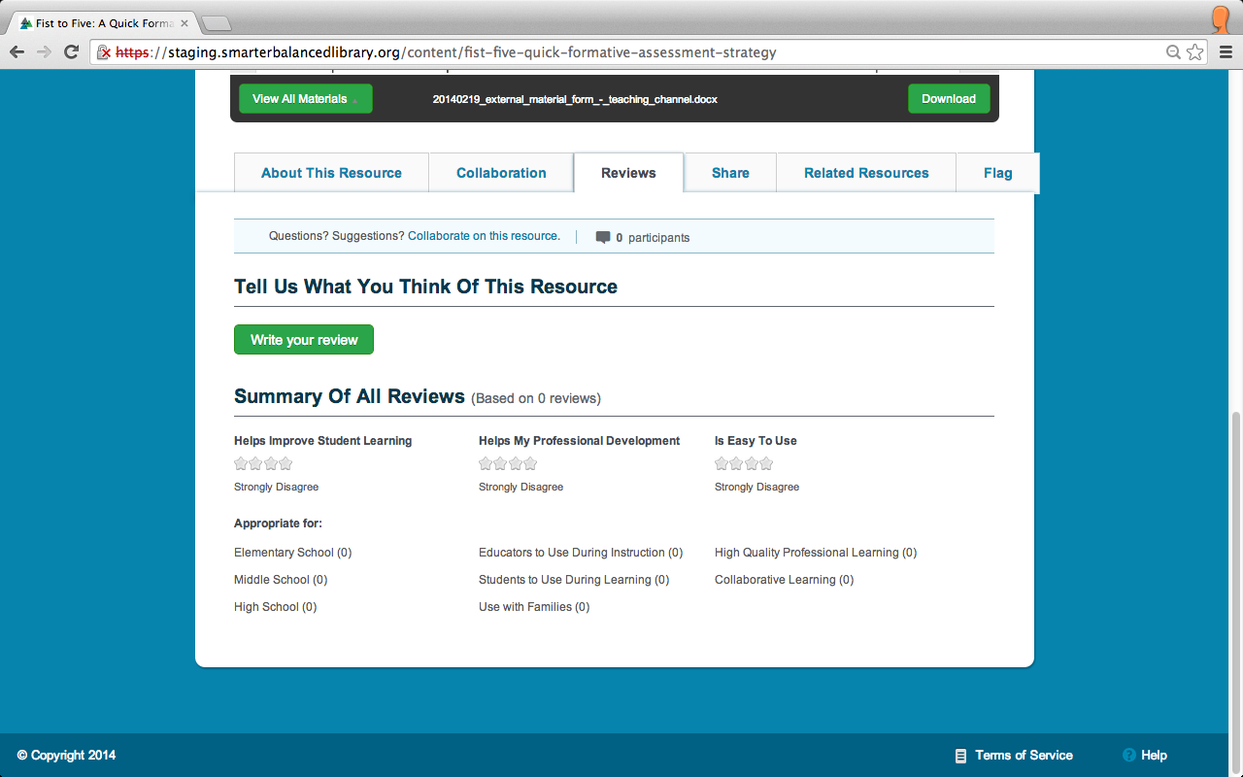
Reviewing and Rating Resources
Notes:
Clicking on the Reviews tab allows you to do two things:
First, you can view a summary of all previous reviews for the resource.
Second, you can write a review of your own. Click Write your review to begin.

Slide 21
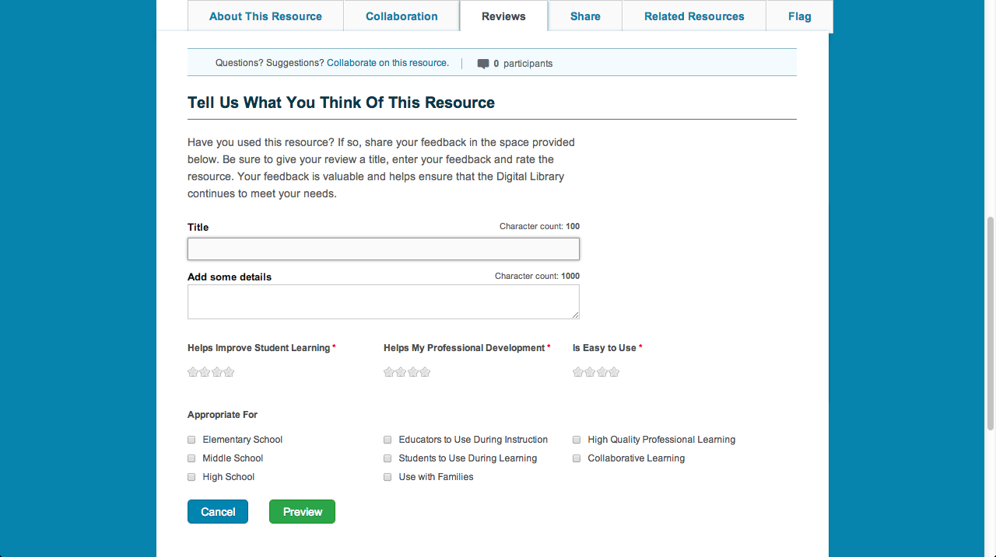
Reviewing and Rating Resources
Notes:
First, enter a title for your review. There is a limit of 100 characters for this field.
Second, complete the Add some details field to share your comments about the resource with other Digital Library users. The limit is 1000 characters.

Slide 22
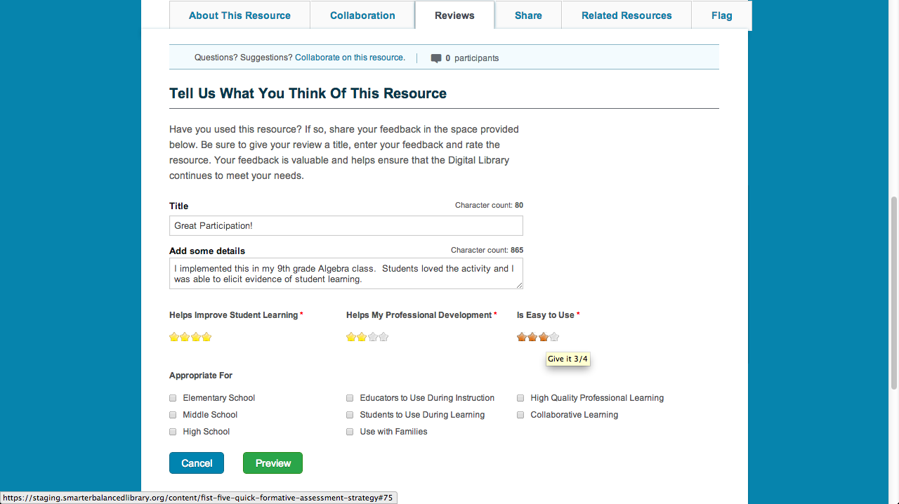
Reviewing and Rating Resources
Notes:
Next, you have the opportunity to rate the resource in three categories:
Helps Improves Student Learning
Helps My Professional Development
Is Easy to Use
Click on the stars to rate each category. 1 star is the lowest rating and 4 stars is the highest.

Slide 23
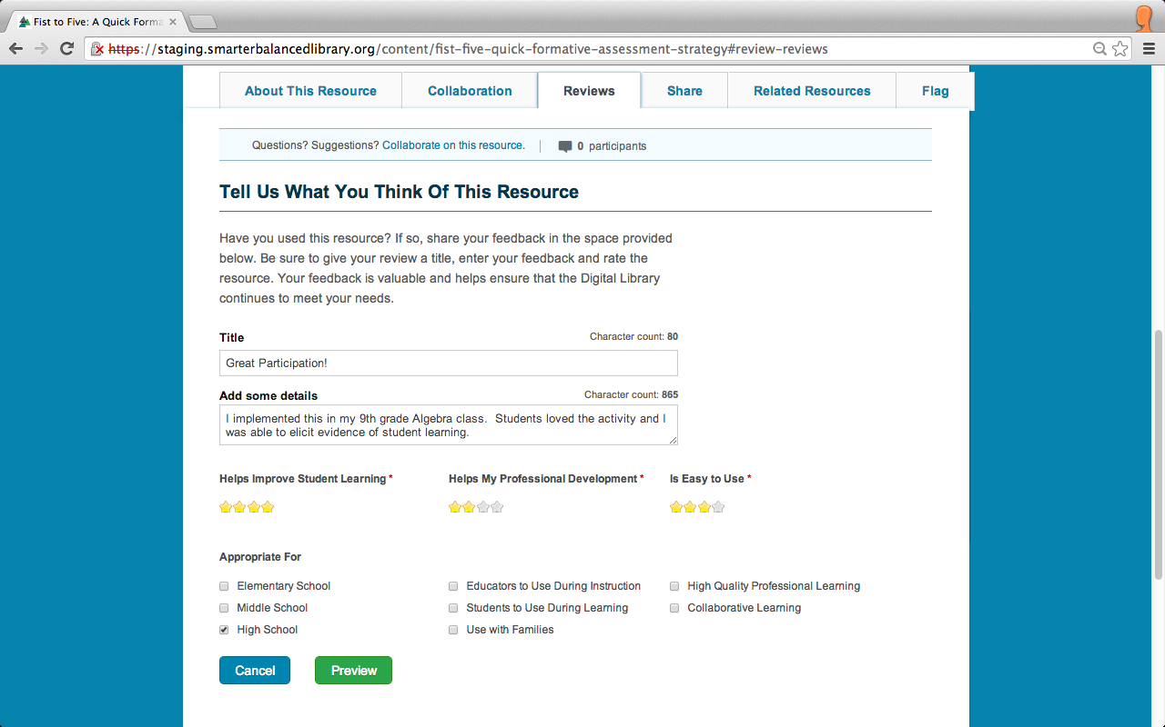
Reviewing and Rating Resources
Notes:
Finally, identify audiences for whom this resource is appropriate by clicking in the boxes.
Once you have completed your review, you can either:
Click Preview to see what your review will appear to others; or
Click Cancel to cancel your review.

Slide 24
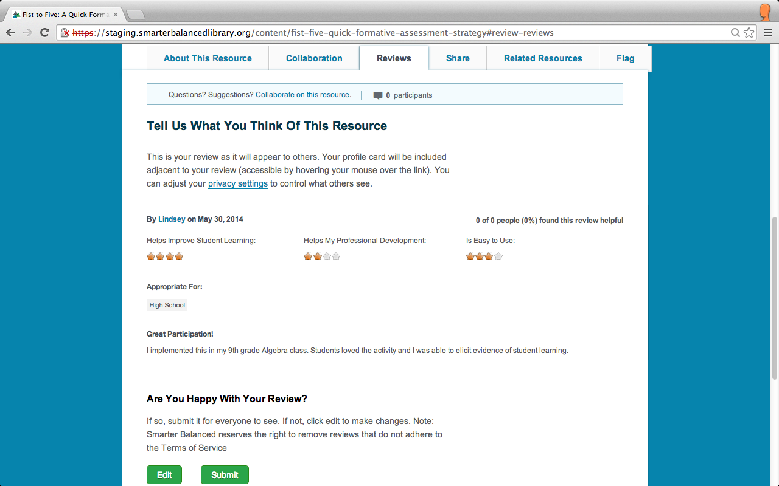
Reviewing and Rating Resources
Notes:
After clicking Preview, you may choose to Edit your review or Submit it.

Slide 25
Topics
How do I view resource materials?
What information will I find in the About This Resource tab?
How do I write a review for a resource and rate it?
How do I share a resource?
How do I locate similar resources in the Digital Library?
How do I flag an issue with a resource in the Digital Library?
Notes:
Let’s see how to share a resource.

Slide 26
Share Resources
Notes:
On the Digital Library Resource tab, click on the title of a resource.

Slide 27
Share Resources
Notes:
After clicking on a resource, scroll below the preview window and click the Share tab.

Slide 28
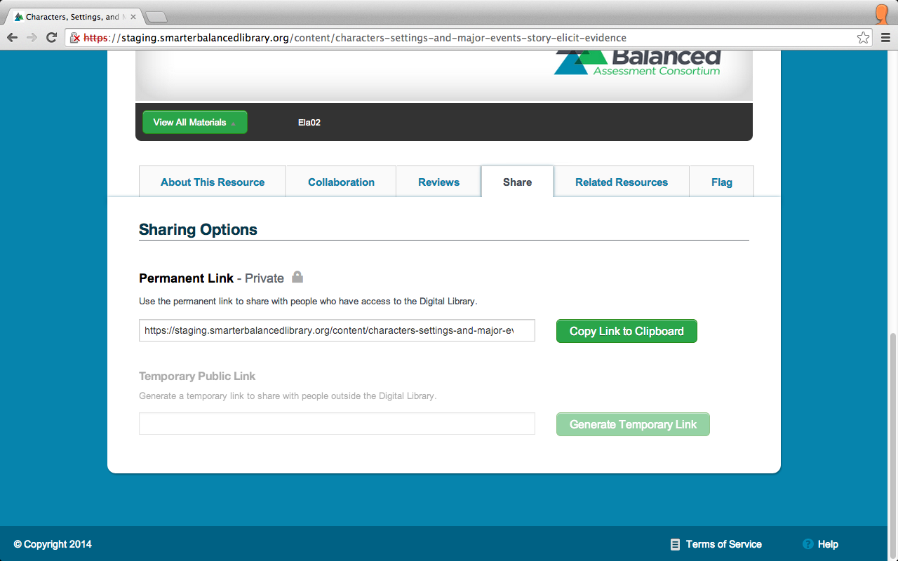
Share Resources
Notes:
On the Share tab, there are two sections.
The first is the Permanent Link which provides a link that allows you to share the resource with other users of the Digital Library. Click Copy Link to Clipboard to copy the link. Then paste it into an email or document.
The Temporary Public Link provides a temporary link that allows you to share the resource with educators outside of the Digital Library.

Slide 29
Topics
How do I view resource materials?
What information will I find in the About This Resource tab?
How do I write a review for a resource and rate it?
How do I share a resource?
How do I locate similar resources in the Digital Library?
How do I flag an issue with a resource in the Digital Library?
Notes:
Let’s review how to find similar resources in the Digital Library.

Slide 30
Similar Resources
Notes:
On the Digital Library Resource tab, click on the title of a resource.

Slide 31
Similar Resources
Notes:
After clicking on a resource, scroll below the preview window and click the Related Resources tab.

Slide 32
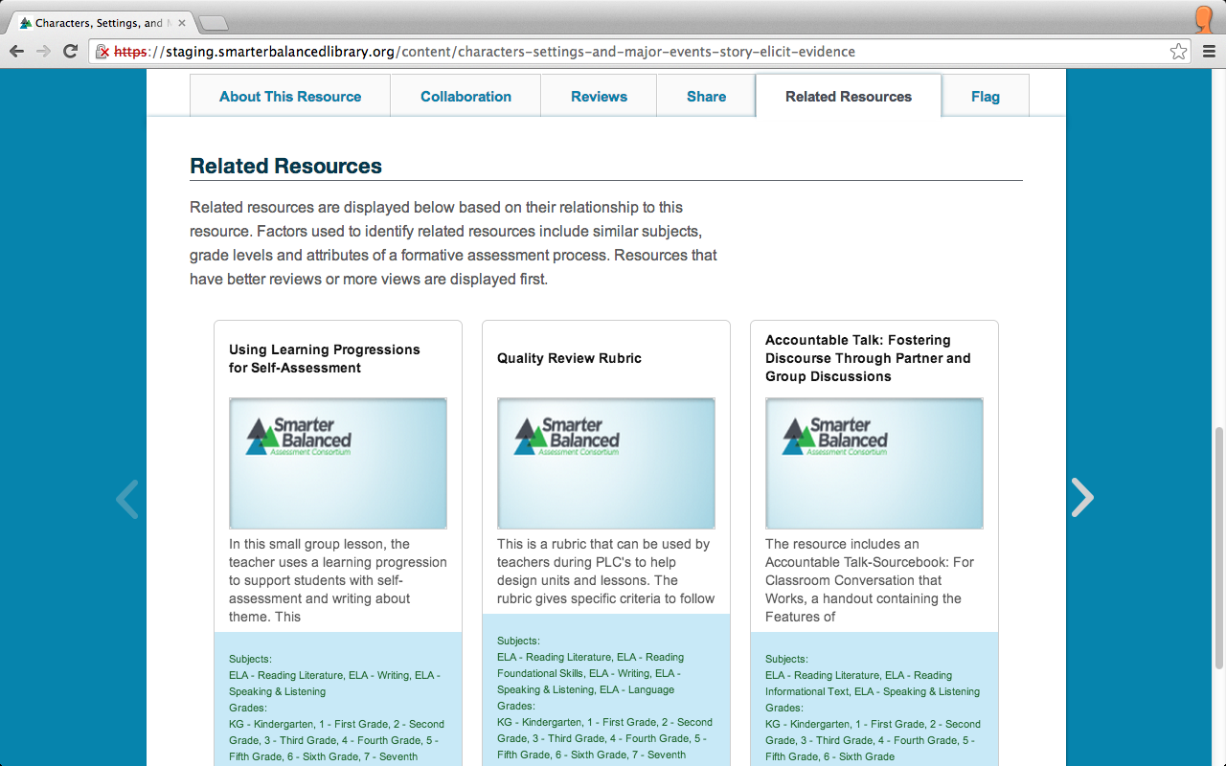
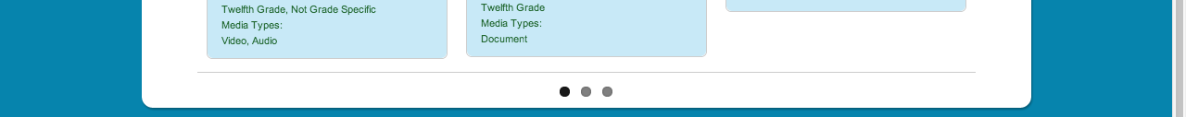
Similar Resources
Notes:
On the Related Resources tab, you will see resources that are similar to the one you selected. They are presented because they have similar subjects, grade levels, and attributes of the Formative Assessment Process. Resources that have higher ratings or more views are displayed first. Click the left and right arrows to view more similar resources.

Slide 33
Topics
How do I view resource materials?
What information will I find in the About This Resource tab?
How do I write a review for a resource and rate it?
How do I share a resource?
How do I locate similar resources in the Digital Library?
How do I flag an issue with a resource in the Digital Library?
Notes:
If you find an issue with a resource in the Digital Library, you can flag it. Moderators will review and address these flags. Let’s see how you can flag a resource.

Slide 34
Flags
Notes:
On the Digital Library Resource tab, click on the title of a resource.

Slide 35
Flags
Notes:
After clicking on a resource, scroll below the preview window and click on the Flag tab.

Slide 36
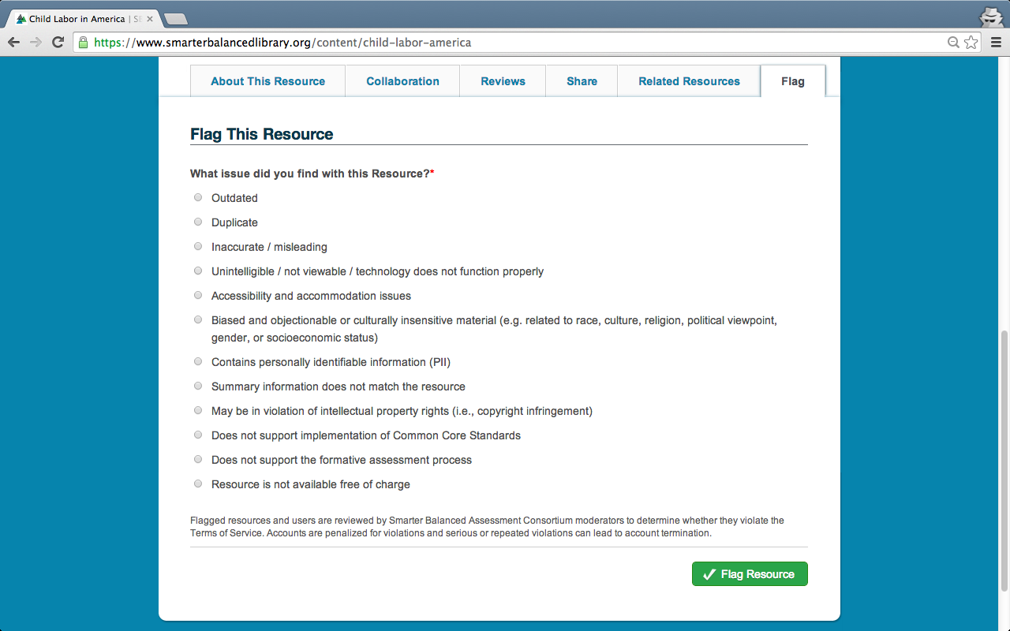
Flags
Notes:
You will see a variety of reasons for flagging a resource, including that it is outdated, contains biased, objectionable, or culturally insensitive material, or does not support the Formative Assessment Process.

Slide 37
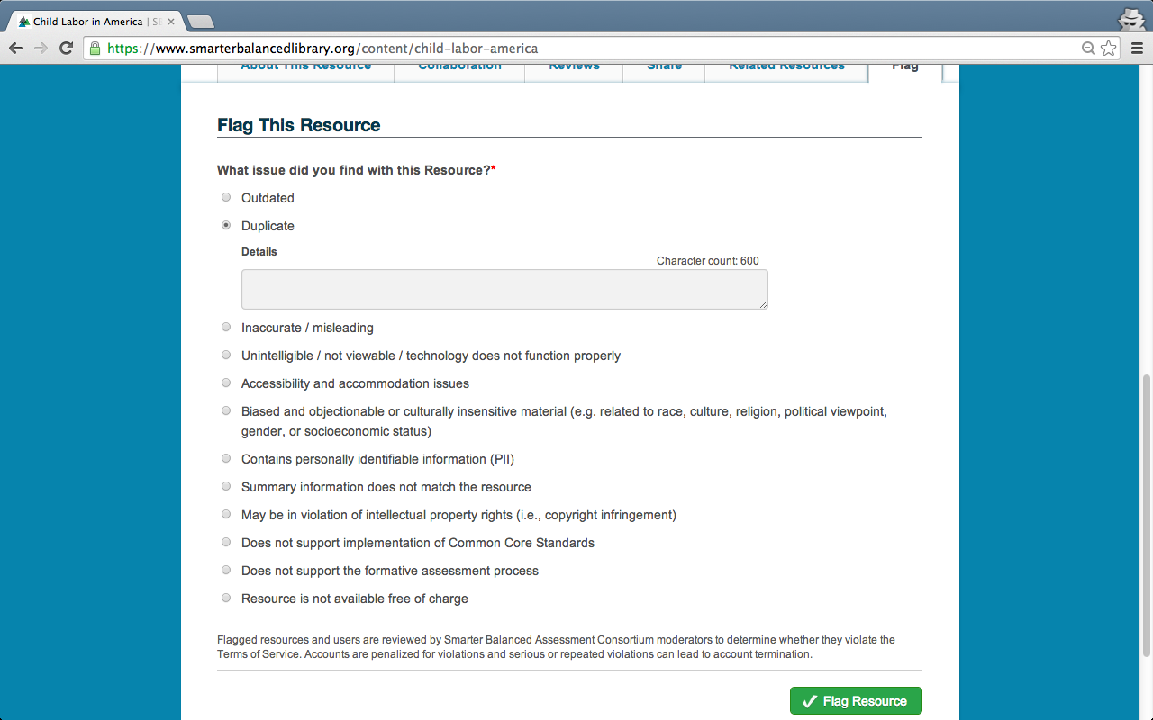
Flags
Notes:
Once you check an issue, a Details box appears.
Explain the issue with the resource in this box, noting that you are limited to 600 characters.
Click Flag Resource to submit your comments.

Slide 38
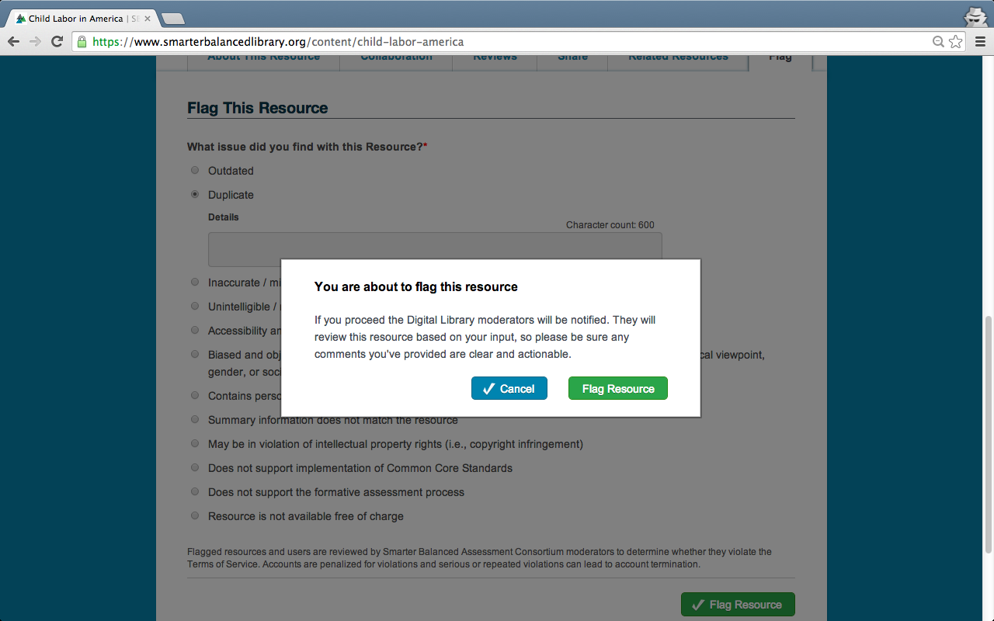
Flags
Notes:
You will be asked to confirm that you would like to flag this resource.
Either click on Flag Resource to submit your comments or click Cancel if you don’t want to continue.

